Slide 1

DATABASE DESIGN & IMPLEMENTATION
Road Sign And Road Map Mobile Notification Application
Task 6
Group 5

Slide 2
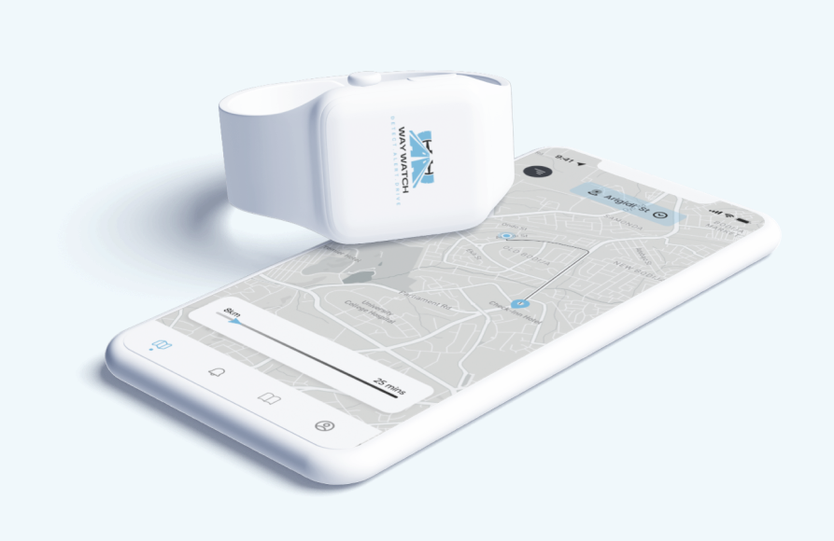
Introduction
Robust PostreSQL database
PostGIS geospatial capabilities
A comprehensive API Implementation
Supporting User Authentication
Real time location tracking
Crowd source internet reporting
Automated Alert Distribution
Comprehensive backend system design

Slide 3

Design Design​ & & implementations Implementation Implementation

Slide 4
Key Architectural Decisions
1 PostgreSQL with PostGIS
3
Geometry(Point, 43260)
5
Spatial Indexing
2 UUID Primary Keys
4
JSONB Data Types

Slide 5
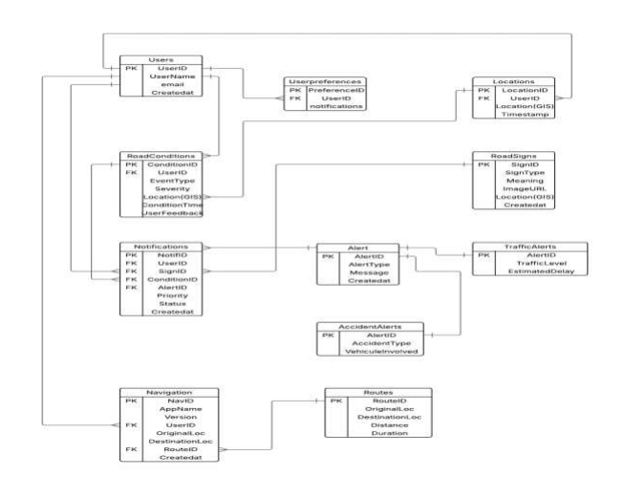
Entity – Relationship Diagram

Slide 6
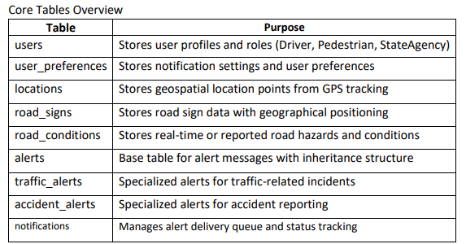
Schema Design & Relationship
The database schema comprises of 12 core tables:
Users
Users preferences
Locations
Road_signs
alerts

Slide 7
Security Measures
2
3
1
Data Validation
Access Control
Data Protection
Reliability Measures
1
2
3
Performance Monitoring
Data Integrity
Backup Recovery

Slide 8

database database Database testing testing testing testing

Slide 9
The Database Implementation underwent comprehensive testin to validate functionality, performance and data integrity with simple query testing like:
1
2
3
Nearby Road Sign Query
User Notification and Retrieval
Road Conditions with Reporter Information

Slide 10
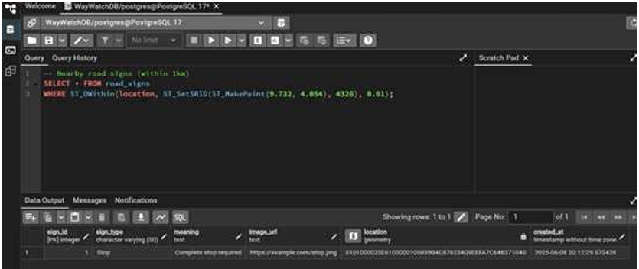
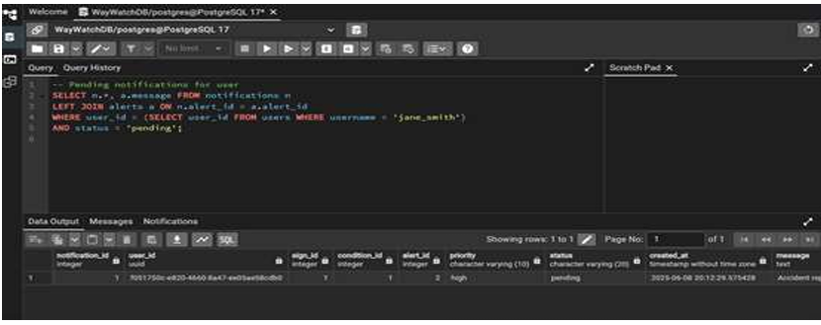
Nearby Road sign query & User Notification Retrival

Slide 11
back-end api back-end api back-end api implementation implementation implementation implementation

Slide 12
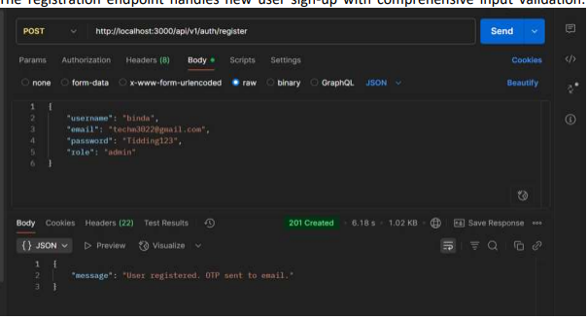
User Authentication System

Slide 13
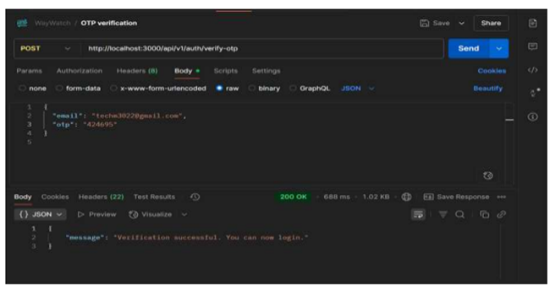
OTP Verification

Slide 14
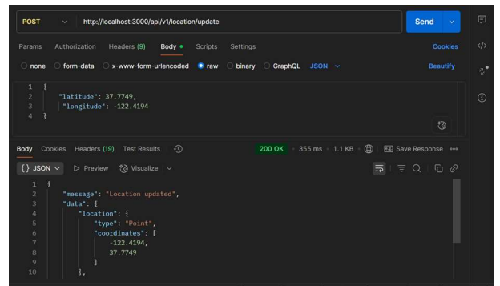
Location Service

Slide 15
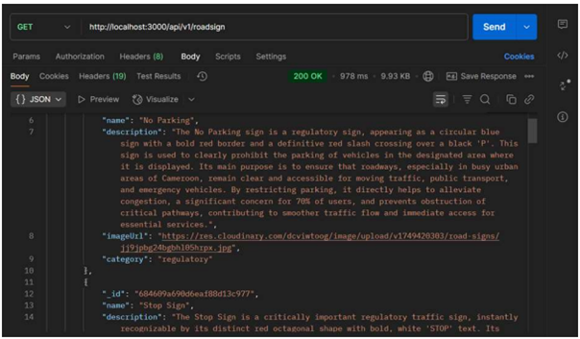
Road Sign Management

Slide 16
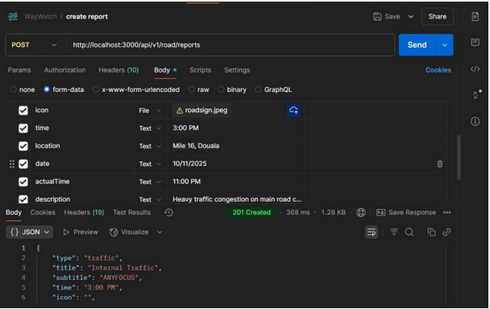
Crowd Reporting & Alert Notification

Slide 17

Thank You

